Slide 1



Webby CREATE YOUR WEBSITE IN A BLINK OF A GLANCE
Cairo University
Faculty of Engineering

Slide 2
Team Members
Aya Ahmed
Salma Ragab
Shredan Abdullah
Nada Osman
Supervised By: Dr. Khaled Soradi

Slide 3
Table of contents
01
02
03
04
05
06
Motivation
Problem Definition
Related
Work
Proposed
Solution
07
Future
Work
System
Architecture
Demo &
Results

Slide 4
Problem Definition
Traditional website development often requires coding skills, making it challenging for individuals without a technical background to create their websites. Also hiring professional web developers can be expensive, particularly for small businesses or individuals.

Slide 5
Motivation
Democratize and simplify the process of creating websites.
Accessibility for Non-Technical Users.
Professional Design Without Design Skills.
Time and Resource Efficiency.
Effortless Communication.

Slide 6
Proposed Solution
Make a website builder that users with limited IT knowledge can use:
Natural Language Interface
Customizing Created Database
Templates
Library
Automated Database Creation
classification & Retrieve
Linking with Backend

Slide 7
Proposed Solution
Natural Language Interface:
Description to Design Translation
Context-Aware Understanding
Real-Time Processing
Dynamic Content Generation
User-Friendly

Slide 8
Proposed Solution
Automated Database Creation:
Initial Database Setup
Entity Recognition and Relationship Mapping
Data Normalization
Predefined Attributes for Entities
Customizing Created Database:
User-Friendly Database Schema Editor
Custom Field Definitions

Slide 9
Proposed Solution
Control over color theme of the site:
Users can easily customize the color scheme to match their brand identity.
Hard copy of the source code:
Users can download a complete hard copy of their website’s source code.
Ensures transparency and control over the website’s backend.
Linking with Backend:
Seamless integration with various backend technologies (e.g., databases).

Slide 10






Related Products
Features
open source | open source on verification | No | No | need verification | No | No
cost | require verification | Free/Paid | Free/Paid | require verification | limited prompts | Paid
Code access | Limited access | Limited access | Limited access | need verification | yes | yes
User input | Selection based | Question-based | Selection based | Selection based | text | text
Build database & CRUD ops | No | No | yes | need verification | yes | yes

Slide 11
System Architecture

Slide 12
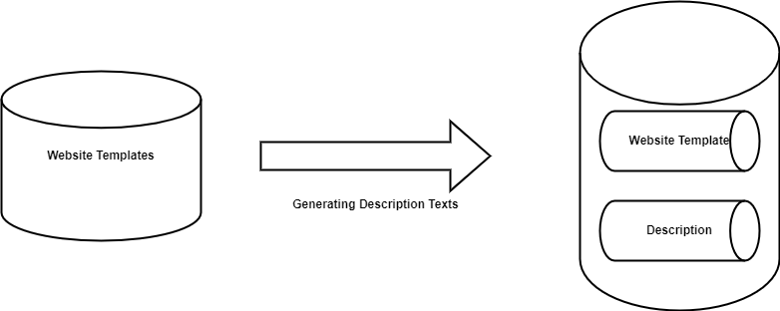
System Architecture
In the first module we worked on gathering data which are website templates as our dataset with constraints where each template consists of HTML/CSS/JS and maybe some of bootstrap.
And Write for each template single description for it.

Slide 13
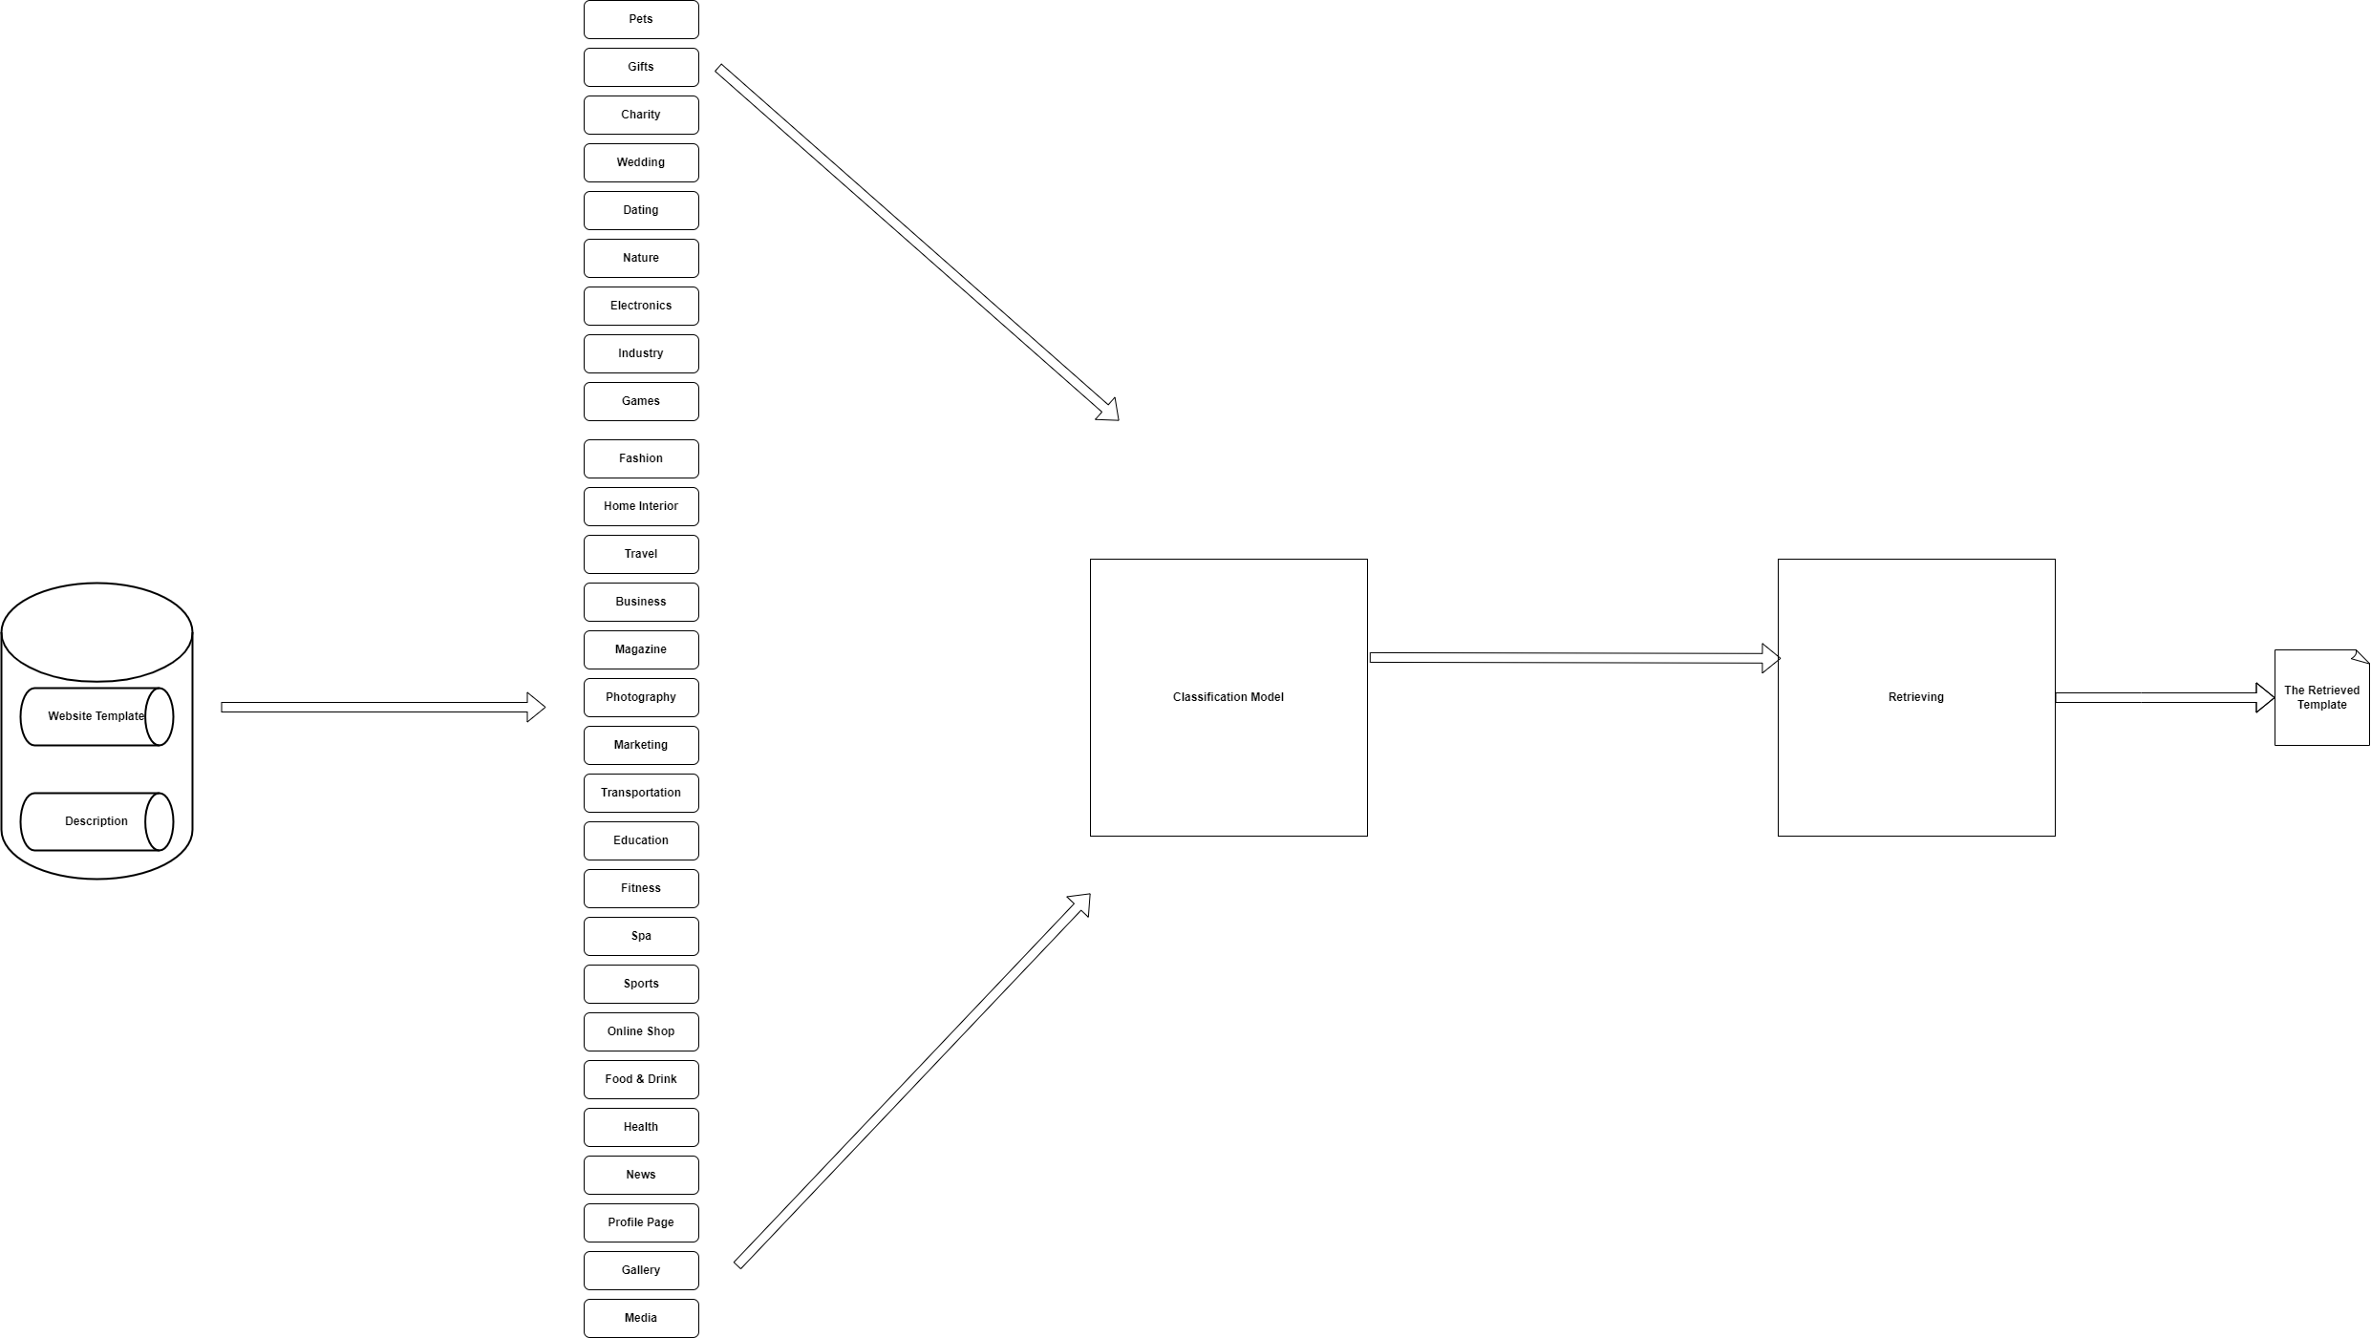

Slide 14
System Architecture
The idea behind choosing machine learning classification methods is that we want to get the template category based on the user input, so we classify this input into certain category that match with user input. Then why retrieving? After knowing which category we’re going to proceed with we retrieve one template from the chosen category based one the cosine similarity between user input and the templates descriptions saved in our library.

Slide 15
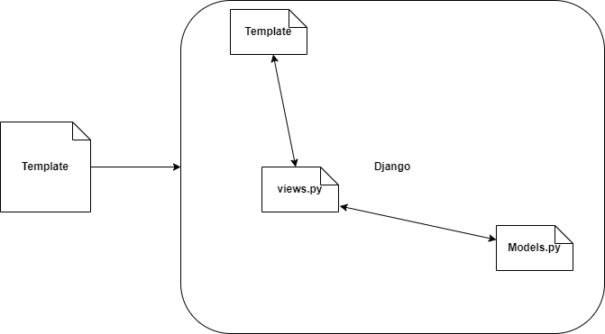
System Architecture

Slide 16
Linking with Backend, how?
We need to link our backend part with front end part via a web framework, so after researches we managed to use Django as our used framework. But how we actually link?
We put an assumption of how the views.py which the model that render the frontend part after responding from the database. We put certain criterion to always have one views that link to parts without any prior information from both sides.
We generalize the most common features in most of the database tables and fields and adapt the templates on it so that we can fix the views and the templates no matter how the data in the database are.

Slide 17
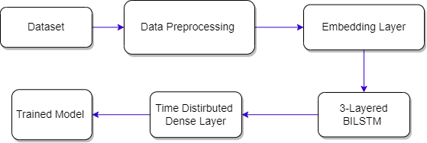
System Architecture
Entities & Attributes Extractor:

Slide 18
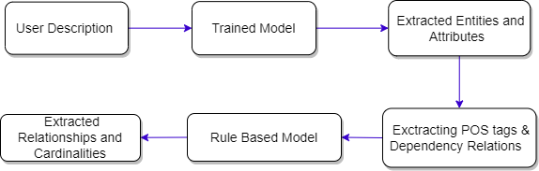
System Architecture
Relationship & Cardinalities Extractor:

Slide 19
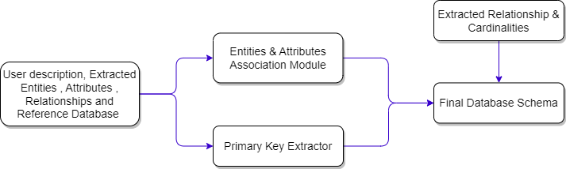
System Architecture
Database Schema Creation:

Slide 20
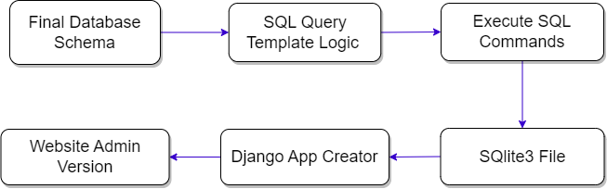
System Architecture
Admin Website Creation:

Slide 21
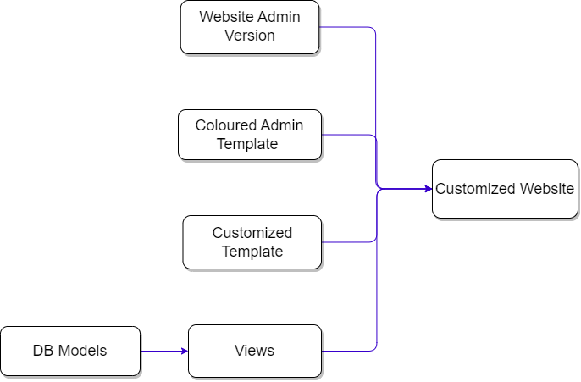
System Architecture
Final Architecture:

Slide 22
Future Work
Template Generalization
Use Framework
Automated Testing
Automated Deployment

Slide 23
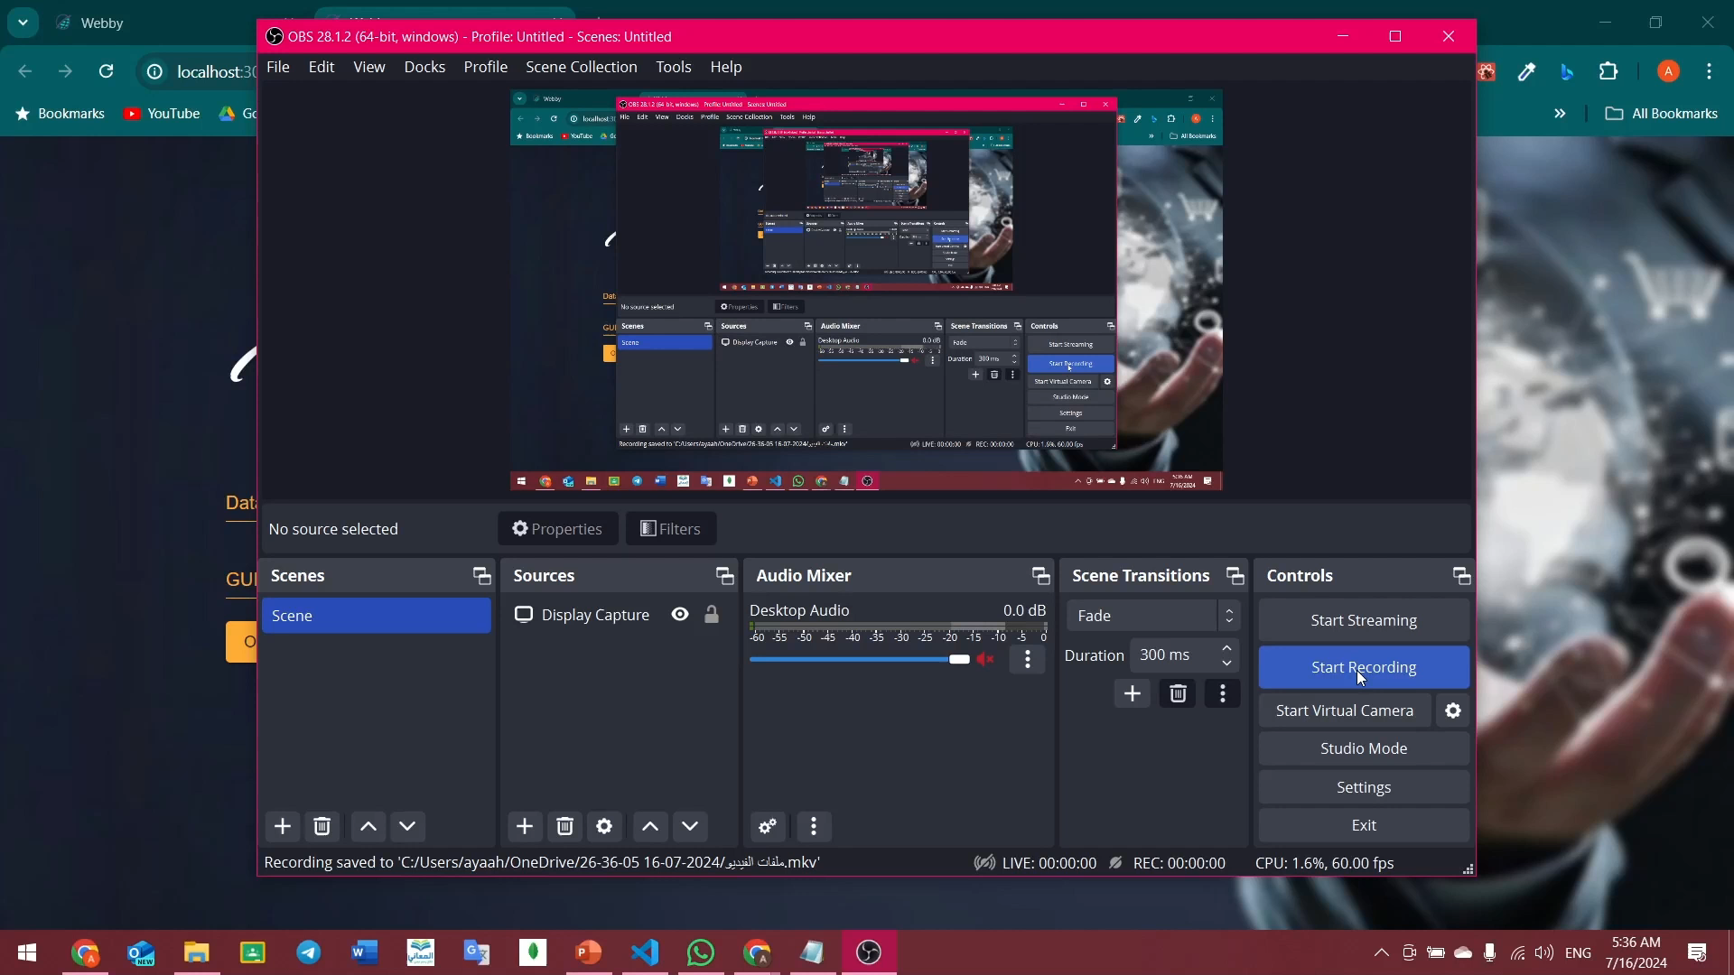
Demo

Slide 24
Project Modules
Aya | entities and attributes rule based (50%) ,neural network model, Dataset generation and collection (50%) , training entities and attributes sentences BILSTM model (50%), relationship extraction and cardinalities rule based ,Django script ,website of the project
Salma | classification, changing colors in CSS files, change style of admin in Django, collect database modify it to link in Django project and create descriptions to each template in data site , participate in integration of whole project and in testing
Shredan | retrieve model, changing in html ,collect database modify it to link in Django project and create descriptions to each template in data site, create views to link database with frontend
Nada | entities and attributes rule based(50%) , ensemble model for entities and attributes, primary key extraction, entities with attributes association, Dataset generation and collection (50%), training entities and attributes sentences BILSTM (50%), SQL queries

Slide 25
Any Questions?

Slide 26
Thank You

